Slide 1
Module 3: Modelling Requirements
Software requirements and its types,
Requirements Engineering process,
Requirement Elicitation
Book: Software Engineering
Eighth Edition, Ian Sommerville
Chapter 6 ■ Software requirements

Slide 2
Requirements Engineering
The process of finding out, analyzing, documenting, and checking these services and constraints is called requirements engineering (RE).
Requirements engineering is concerned with establishing what the system should do, its desired and essential properties, and the constraints on system operation and the software development processes.
You can therefore think of requirements engineering as the communications process between the software customers and users and the software developers.

Slide 3
What is a requirement?
It may range from a high-level abstract statement of a service or of a system, constraint to a detailed mathematical functional specification.
Types of requirement
User requirements are statements, in a natural language plus diagrams, of what services the system is expected to provide and the constraints under which it must operate.
System requirements set out the system’s functions, services and operational constraints in detail. The system requirements document should define exactly what is to be implemented. It may be part of the contract between the system buyer and the software developers.

Slide 4
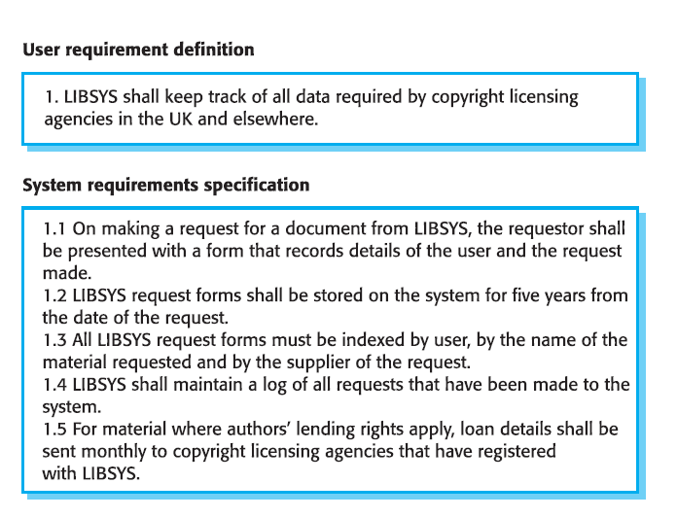
Example 1
This example from a library system
shows how a user requirement may be expanded into several system requirements.
You can see from Figure 6.1 that the user requirement is more abstract, and the system requirements add detail, explaining the services and functions that should be provided by the system to be developed

Slide 5
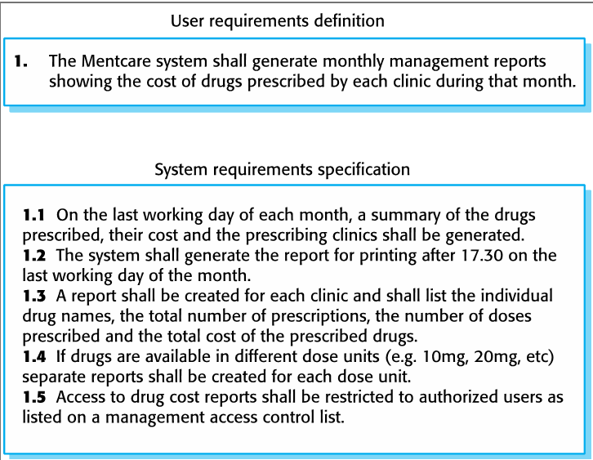
Example 2

Slide 6
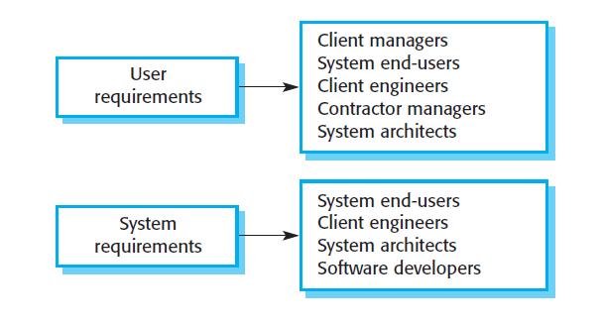
System stakeholders
Any person or organization who is affected by the system in some way and so who has a legitimate interest
Stakeholder types
End users
System managers
System owners
External stakeholders

Slide 7
Functional and Non-Functional requirements

Slide 8
Functional and non-functional requirements
Functional requirements
Statements of services the system should provide, how the system should react to particular inputs, and how the system should behave in particular situations.
May state what the system should not do.
Specified by the user
Non-functional requirements
Good attributes
Constraints on the services or functions offered by the system such as timing constraints, constraints on the development process, standards, etc.
Often apply to the system as a whole rather than individual features or services.
Specified by Technical people such as Architect, software developers
Domain requirements
Domain requirements are derived from the application domain of the system rather than from the specific needs of system users

Slide 9
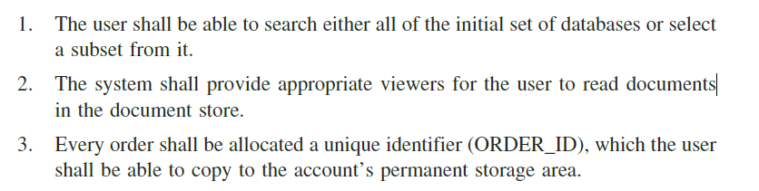
Example: Functional requirements
Functional requirements for a software system may be expressed in a number of ways. For example, here are examples of functional requirements for a university library system called LIBSYS, used by students and faculty to order books and documents from other libraries:

Slide 10
Non-functional requirements
Non-functional requirements, as the name suggests, are requirements that are not directly concerned with the specific functions delivered by the system.
They may relate to emergent system properties such as reliability, response time and store occupancy.
Non-functional requirements are rarely associated with individual system features.
more critical than individual functional requirements
failing to meet a non-functional requirement can mean that the whole system is unusable.
Non-functional requirements arise through user needs, because of budget constraints, because of organisational policies, because of the need for interoperability with other software or hardware systems, or because of external factors such as safety regulations or privacy legislation

Slide 11
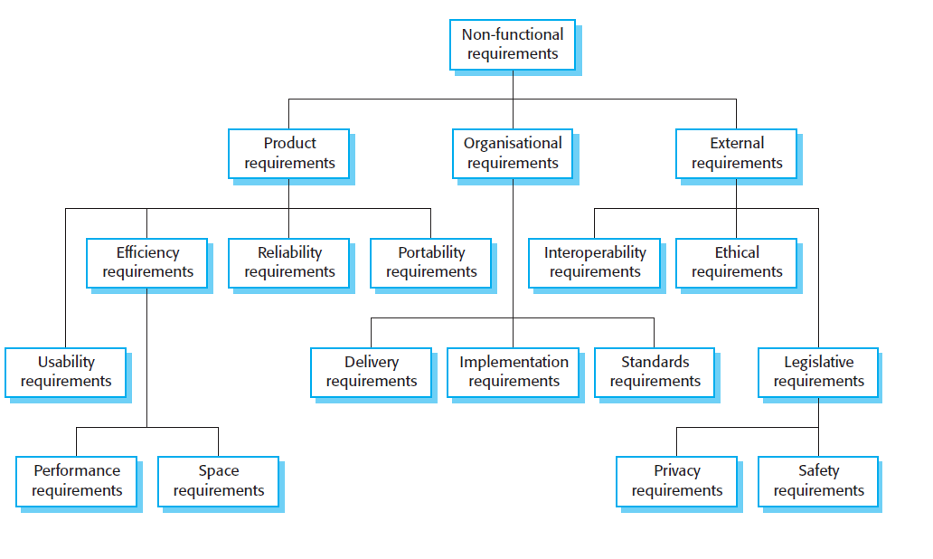

Slide 12
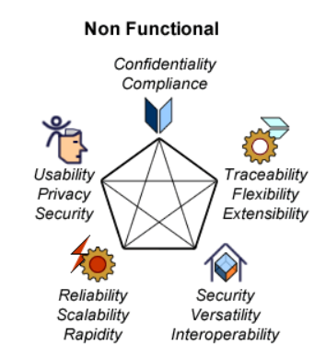
Non-functional Requirements
Scalability
Capacity
Data integration
Recoverability
Availability

Slide 13
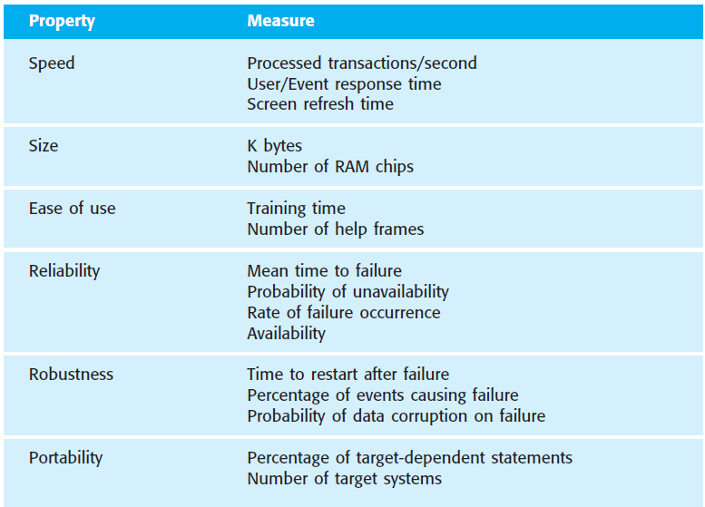
Metrics for specifying non-functional requirements

Slide 14
Requirements engineering processes Chapter 7

Slide 15
Requirements engineering processes
The processes used for RE vary widely depending on the application domain, the people involved and the organisation developing the requirements.
However, there are a number of generic activities common to all processes
Requirements elicitation;
Requirements analysis;
Requirement specification;
Requirements validation;
Requirements management.
In practice, RE is an iterative activity in which these processes are interleaved.

Slide 16
Requirements engineering process
The goal of the requirements engineering process is to create and maintain a system requirements document. The overall process includes four high-level requirements engineering sub-processes. These are concerned with:
assessing whether the system is useful to the business (feasibility study);
discovering requirements (elicitation and analysis);
converting these requirements into some standard form (specification);
and checking that the requirements actually define the system that the customer wants (validation).

Slide 17
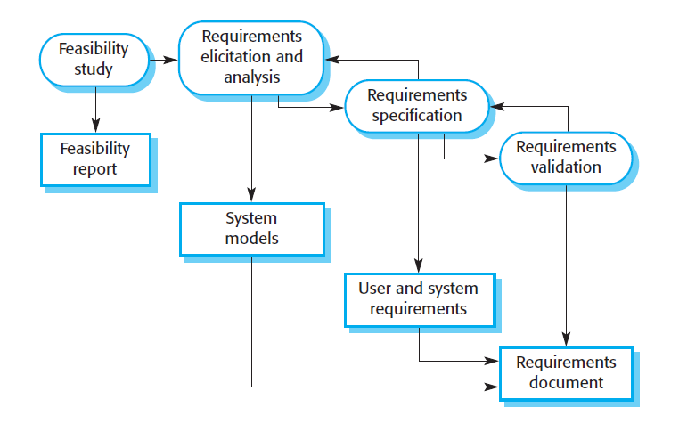
The requirements engineering process
The activities shown in this figure are concerned with the discovery, documentation and checking of requirements. In virtually all systems, however, requirements change. The people involved develop a better understanding of what they want the software to do; the organisation buying the system changes; modifications are made to the system’s hardware, software and organisational environment. The process of managing these changing requirements is called requirements management, which is covered in the final section of this chapter.

Slide 18
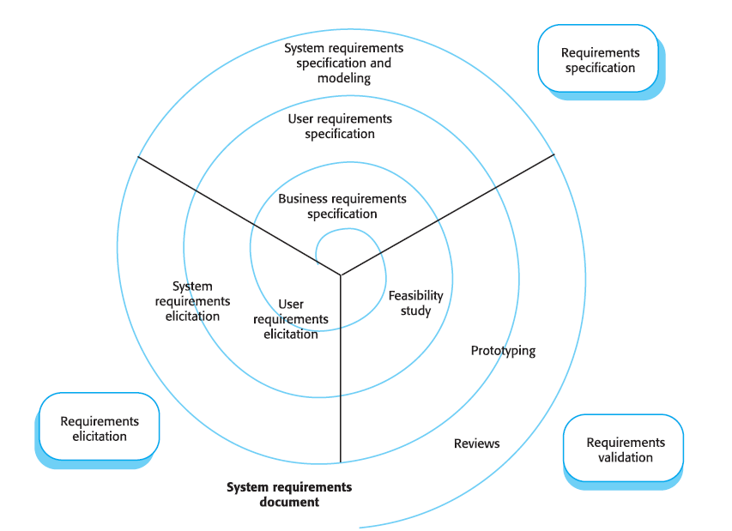
Spiral model of RE
This presents the process as a three-stage activity where the activities are organised as an iterative process around a spiral.
The amount of time and effort devoted to each activity in an iteration depends on the stage of the overall process and the type of system being developed.
Early in the process, most effort will be spent on understanding high-level business and non-functional requirements and the user requirements.
Later in the process, in the outer rings of the spiral, more effort will be devoted to system requirements engineering and system modelling.
The number of iterations around the spiral can vary

Slide 19
FEASIBILITY STUDY
A Feasibility should answer three questions
Does the system contribute to the overall objectives of the organization?
Can the system be implemented within schedule and budget using current technology?
Can the system be integrated with other systems that are used?
If these questions are satisfied only we have to go ahead with the project.

Slide 20
Requirements elicitation
Sometimes called requirements elicitation or requirements discovery.
Involves technical staff working with customers to find out about the application domain, the services that the system should provide, and the system’s operational constraints.
May involve end-users, managers, engineers involved in maintenance, domain experts, trade unions, etc. These are called stakeholders.

Slide 21
Requirements elicitation
Software engineers work with a range of system stakeholders to find out about the application domain, the services that the system should provide, the required system performance, hardware constraints, other systems, etc.
Stages include:
Requirements discovery,
Requirements classification and organization,
Requirements prioritization and negotiation,
Requirements specification.

Slide 22
Problems of requirements elicitation
Stakeholders don’t know what they really want.
Stakeholders express requirements in their own words.
Different stakeholders may have conflicting requirements.
Organizational and political factors may influence the system requirements.
The requirements change during the analysis process. New stakeholders may emerge and the business environment may change.

Slide 23
The requirements elicitation and analysis process
Requirements discovery
Interacting with stakeholders to discover their requirements. Domain requirements are also discovered at this stage.
Requirements classification and organization
Groups related requirements and organises them into coherent clusters.
Prioritization and negotiation
Prioritizing requirements and resolving requirements conflicts.
Requirements specification
Requirements are documented and input into the next round of the spiral.

Slide 24
Requirement Elicitation Techniques
Requirements elicitation involves meeting with stakeholders of different kinds to discover information about the proposed system
Interviewing
Ethnography
Stories and scenarios
User cases

Slide 25
Interviewing
Formal or informal interviews with stakeholders are part of most RE processes.
Types of interview
Closed interviews based on a pre-determined list of questions
Open interviews where various issues are explored with stakeholders.
Effective interviewing
Be open-minded, avoid pre-conceived ideas about the requirements, and are willing to listen to stakeholders.
Prompt the interviewee to get discussions going using a springboard question, a requirements proposal, or by working together on a prototype system.
Normally a mix of closed and open-ended interviewing.
Interviews are good for getting an overall understanding of what stakeholders do and how they might interact with the system.
Interviewers need to be open-minded without pre-conceived ideas of what the system should do
You need to prompt the user to talk about the system by suggesting requirements rather than simply asking them what they want.

Slide 26
Problems with interviews
Application specialists may use language to describe their work that isn’t easy for the requirements engineer to understand.
Interviews are not good for understanding domain requirements
Requirements engineers cannot understand specific domain terminology;
Some domain knowledge is so familiar that people find it hard to articulate or think that it isn’t worth articulating.

Slide 27
Ethnography
Def: Ethnography is an observational technique that can be used to understand social and organisational requirements. An analyst immerses him or herself in the working environment where the system will be used. He or she observes the day-to-day work and notes made of the actual tasks in which participants are involved. The value of ethnography is that it helps analysts discover implicit system requirements that reflect the actual rather than the formal processes in which people are involved
A social scientist spends considerable time observing and analyzing how people actually work.
People do not have to explain or articulate their work.
Social and organizational factors of importance may be observed.
Ethnographic studies have shown that work is usually richer and more complex than suggested by simple system models.
Requirements derived from the way that people actually work rather than the way we process definitions suggest that they ought to work.
Requirements that are derived from cooperation and awareness of other people’s activities.
Awareness of what other people are doing leads to changes in how we do things.
Ethnography is effective for understanding existing processes but cannot identify new features that should be added to a system.

Slide 28
Stories and scenarios
Scenarios and user stories are real-life examples of how a system can be used.
Stories and scenarios are a description of how a system may be used for a particular task.
Because they are based on a practical situation, stakeholders can relate to them and comment on their situation regarding the story.
A structured form of the user story
Scenarios should include
A description of the starting situation;
A description of the normal flow of events;
A description of what can go wrong;
Information about other concurrent activities;
A description of the state when the scenario finishes.

Slide 29
Use-cases
Use-cases are a scenario-based technique for requirements elicitation which were first introduced in the Objectory method
In their simplest form, a use-case identifies the type of interaction and the actors involved

Slide 30
Requirements validation
Requirements validation is concerned with showing that the requirements actually m define the system that the customer wants
These checks include:
1. Validity checks A user may think that a system is needed to perform certain functions.
Consistency checks Requirements in the document should not conflict
Completeness checks The requirements document should include requirements, which define all functions, and constraints intended by the system users
Realism checks Using knowledge of existing technology, the requirements should be checked to ensure that they could actually be implemented
Verifiability To reduce the potential for dispute between customer and contractor, system requirements should always be written so that they are verifiable
Requirements management

Slide 31
Requirements management
Furthermore, once a system has been installed, new requirements inevitably emerge. Requirements management is the process of understanding and controlling changes to system requirements. You need to keep track of individual requirements and maintain links between dependent requirements so that you can assess the impact of requirements changes.

Slide 32
Requirements specification

Slide 33
The process of writing the user and system requirements in a requirements document.
User requirements have to be understandable by end-users and customers who do not have a technical background.
System requirements are more detailed requirements and may include more technical information.
The requirements may be part of a contract for the system development
It is therefore important that these are as complete as possible.

